Slide 1
Gen AI & Classic ML
when to use what
October 2024
Felix Wick

Slide 2
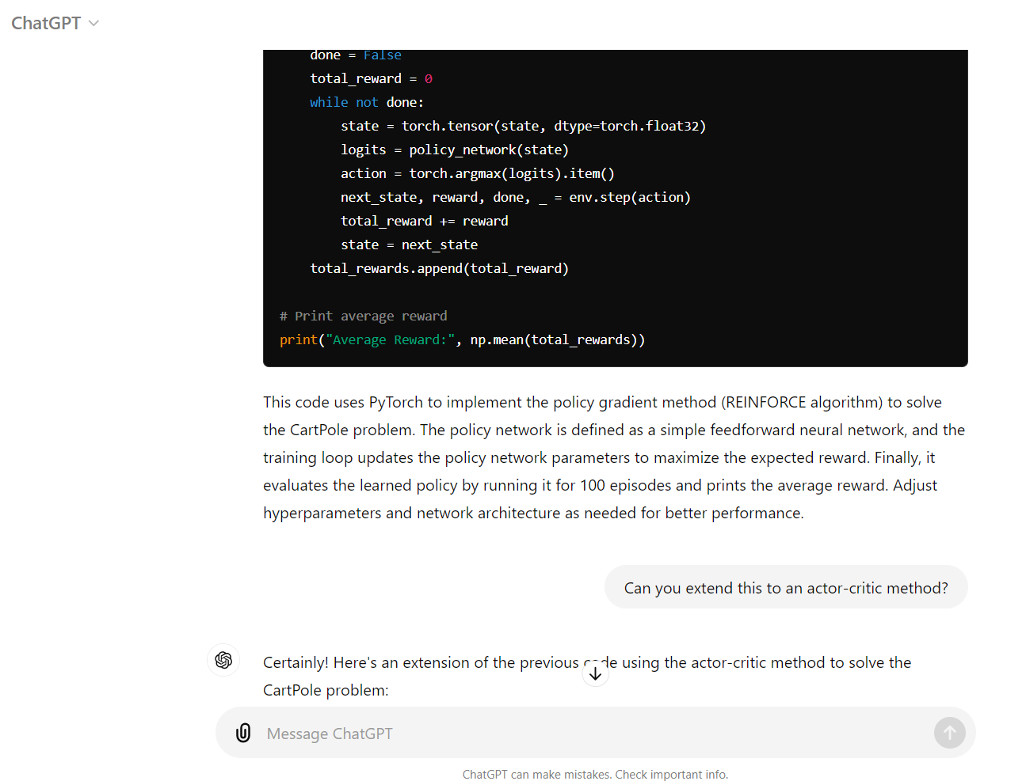
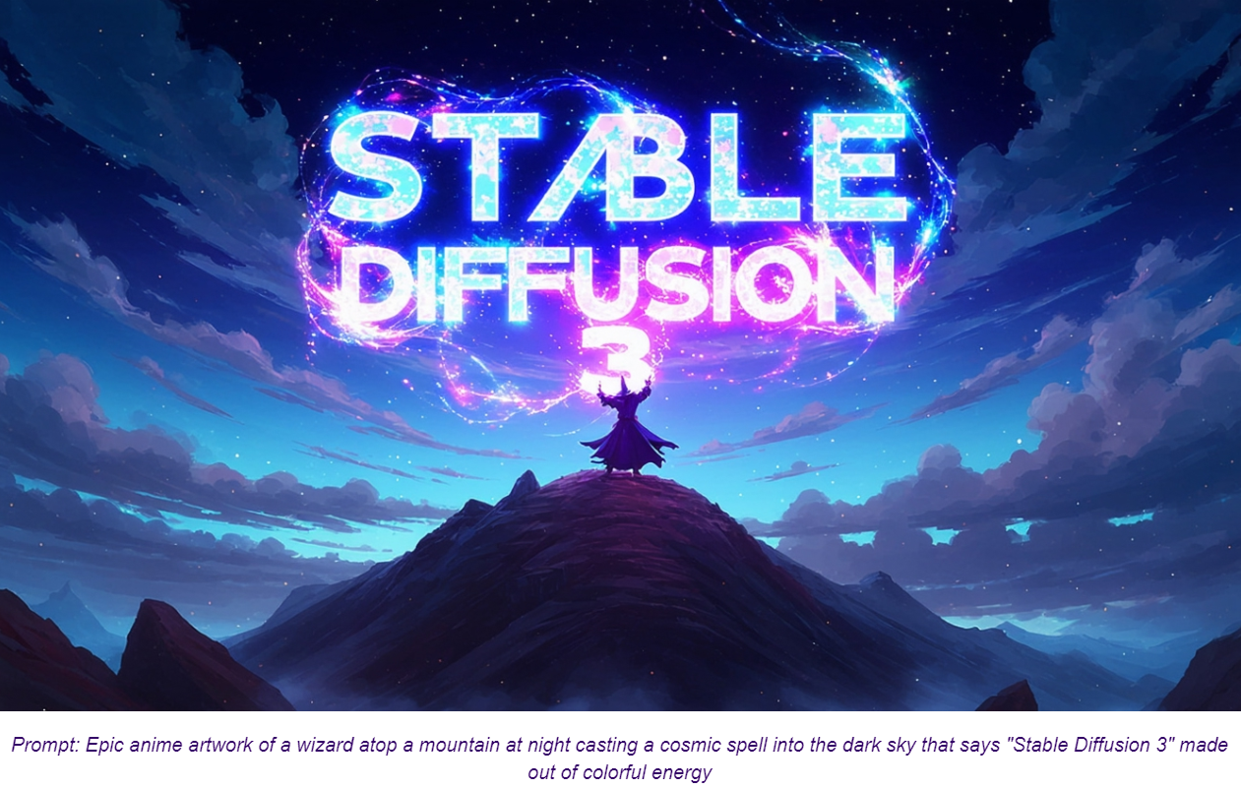
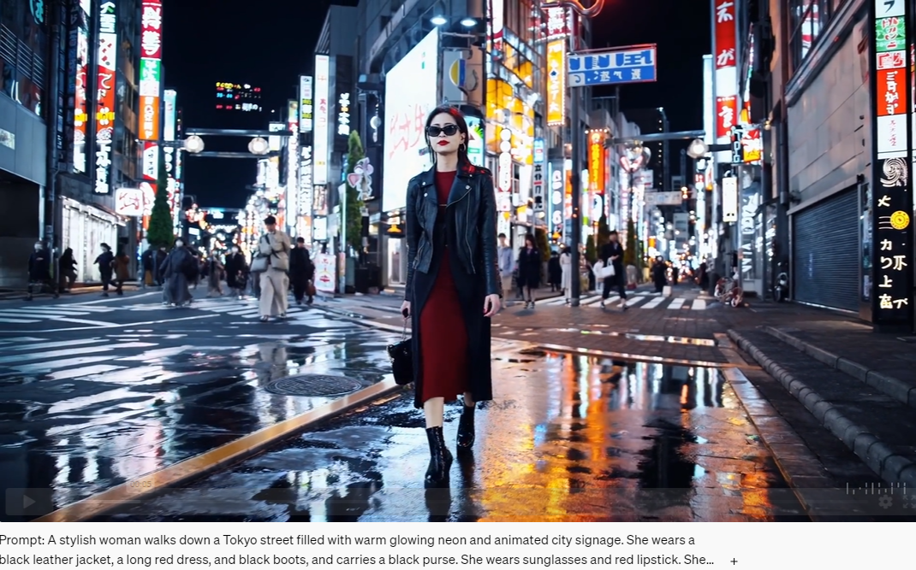
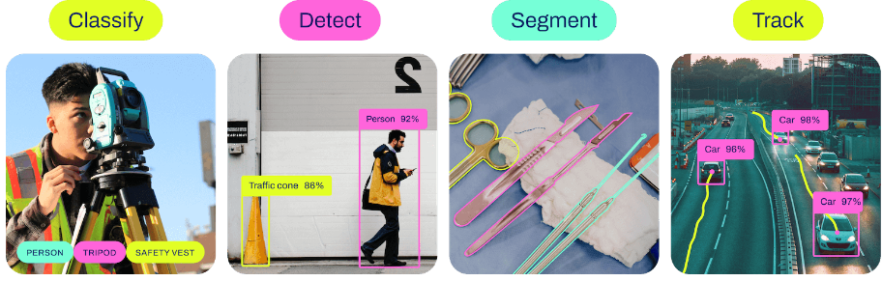
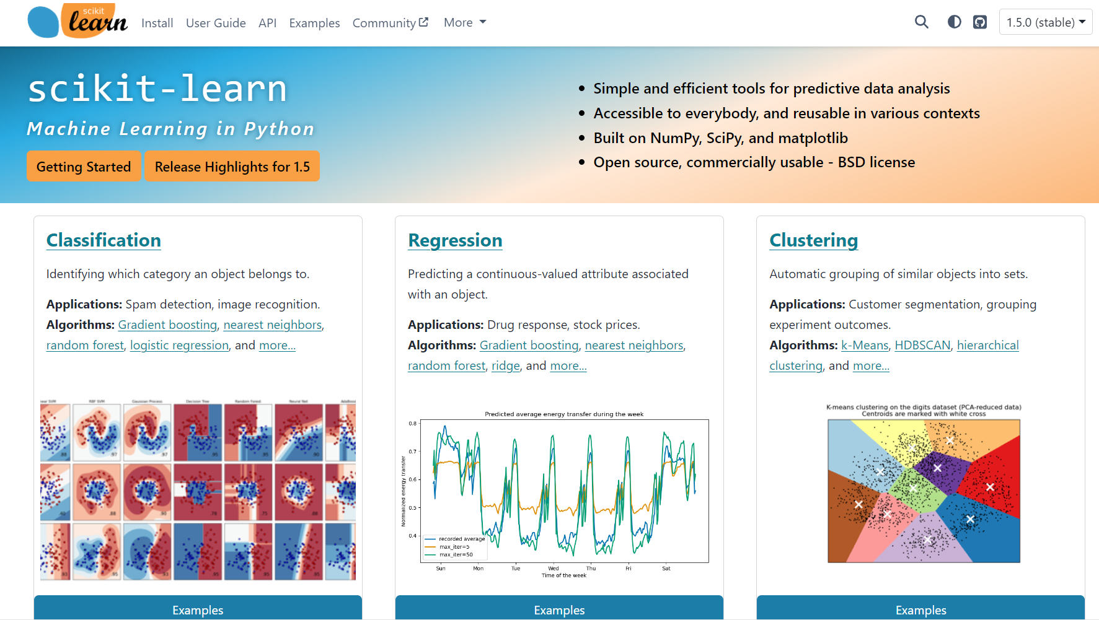

Classic ML vs Deep Learning
Generative vs Predictive Models
text generation
image synthesis
text-to-video
ChatGPT
Stable Diffusion 3 — Stability AI
Sora | OpenAI
BERT family
tabular data
computer vision
YOLO

Slide 3
Deep Learning & Foundation Models

Slide 4

Classic Supervised Learning
input-output mapping
specific models for each task and data set
feature engineering
Example: Spam Filtering
Classify emails as spam or no spam
use information like occurrence of specific words or email length as features
features x1 and x2 spam, no spam
use accordingly labeled emails as training set

Slide 5
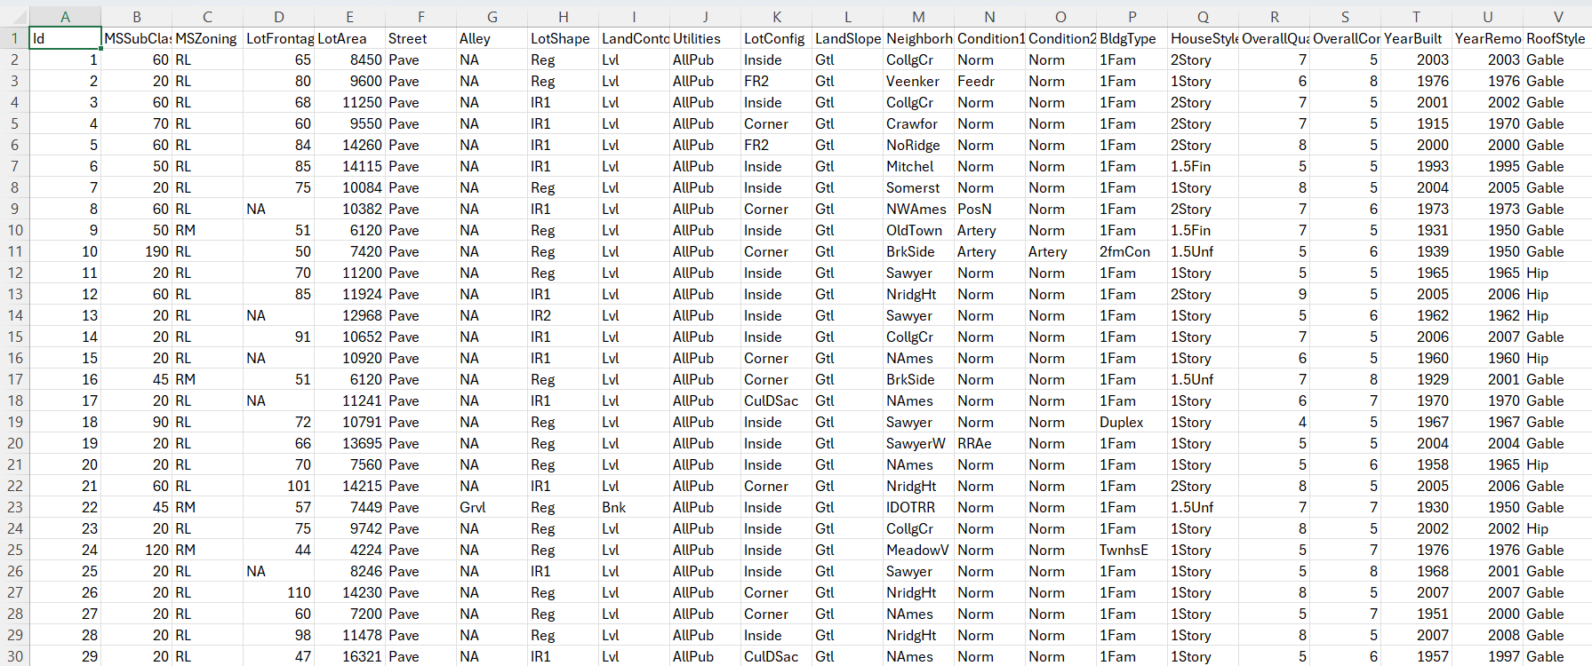
Classic ML Use Cases
plenty of applications:
prediction of house prices
energy consumption prediction
demand forecasting
churn prediction
forecast of traffic conditions
weather forecasts
predictive maintenance
…
You got it, these are predictive models.

Slide 6


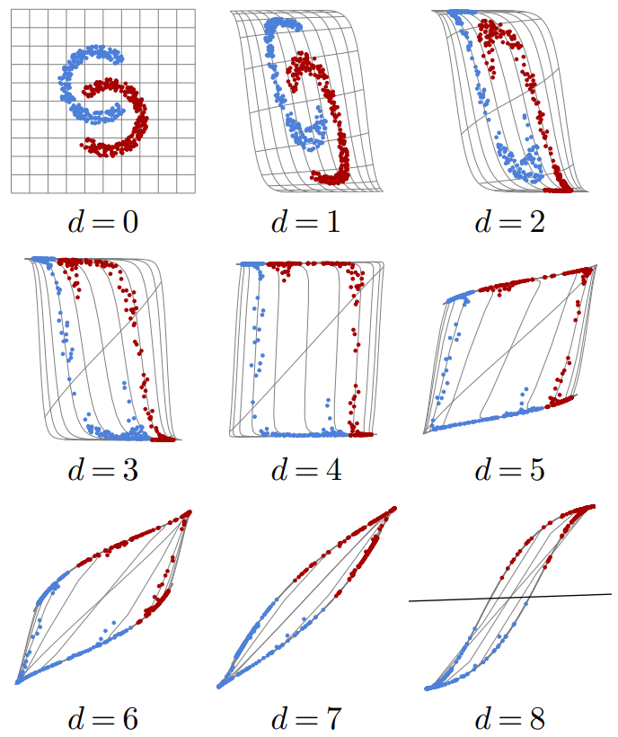
Ladder of Generalization
classic ML: feature engineering
deep learning: feature learning
(hierarchy of concepts learned from raw data in deep graph with many layers)
source
source
source

Slide 7
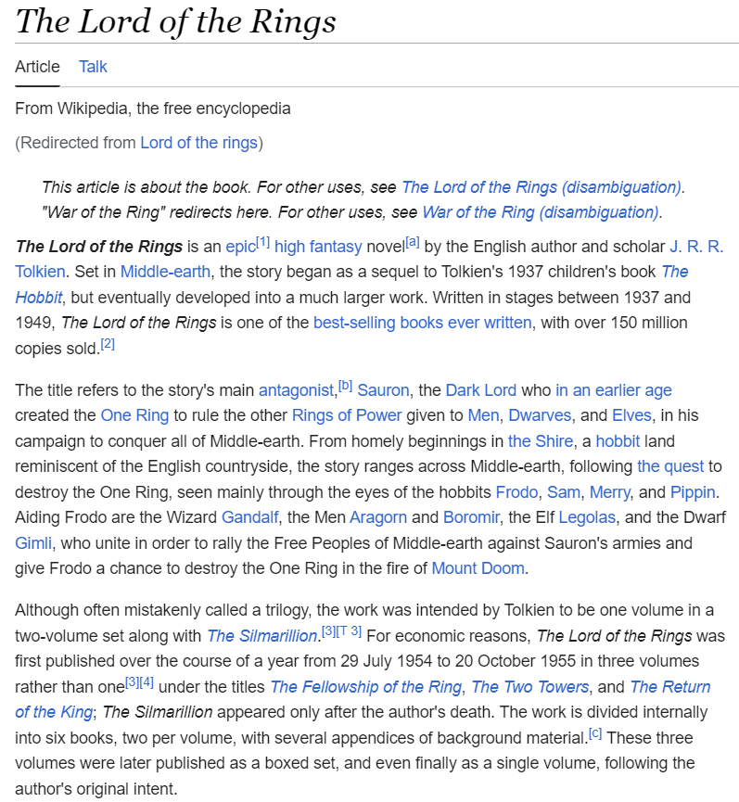
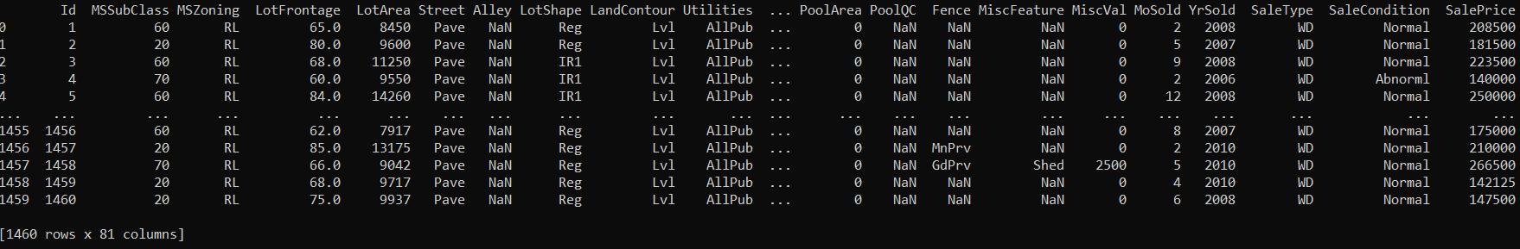
Structured/Tabular vs Unstructured Data
unstructured data: homogenous
→ deep learning rules
→ allows transfer learning (foundation models in CV and NLP)
structured data: heterogenous
→ feature engineering needed
deep learning loses its advantage over shallow methods
→ e.g., gradient boosting still used a lot
ImageNet

Slide 8
Transfer Learning
idea:
generic pre-training of foundation models on huge data sets
subsequent finetuning for specific tasks on small(er) data sets
(usually done with deep learning methods, using its compositional nature)
very successful for:
computer vision (e.g., object classification)
language models (e.g., BERT, GPT)
not (yet) for tabular data (due to its notorious heterogeneity)
(but some promising research, e.g., Chronos for univariate time series)

Slide 9

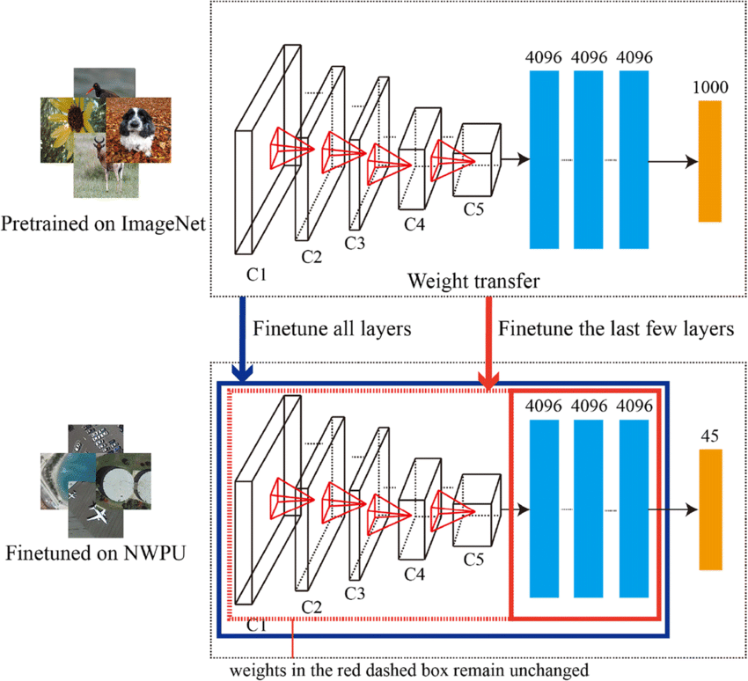

CNN Finetuning
source
object classification
from wikipedia
source

Slide 10
Computer Vision Use Cases
many use cases:
visual defect detection
face recognition
perception for autonomous driving, drone control, …
cellular segmentation
support chip design
…
YOLO
Again, these are no generative, but predictive models.
But aspects of it can be applied in generative ones (e.g., U-Net in diffusion models).

Slide 11
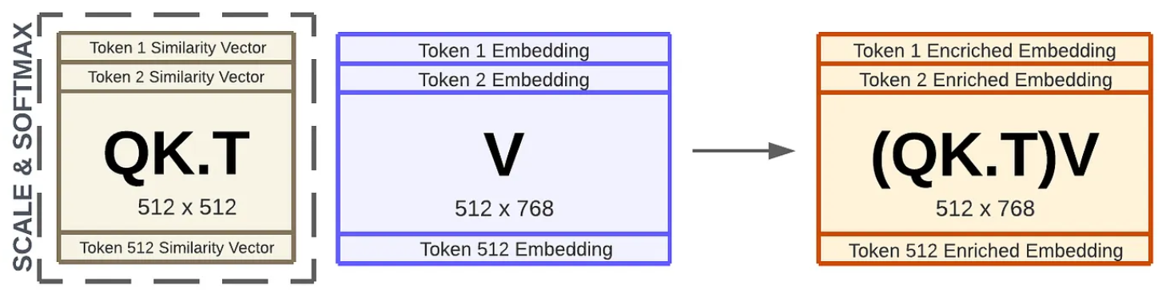
Language Models: Contextual Semantics
self-supervised learning: e.g., next/masked-word prediction
tokenization: split text into chunks (e.g., words)
semantics by means of vector embeddings: e.g., via bag-of-words (or end-to-end in transformer)
positional encoding & embeddings: order of sequence
contextual embeddings: (self-)attention (weighted averages: influence from other tokens)
source

Slide 12

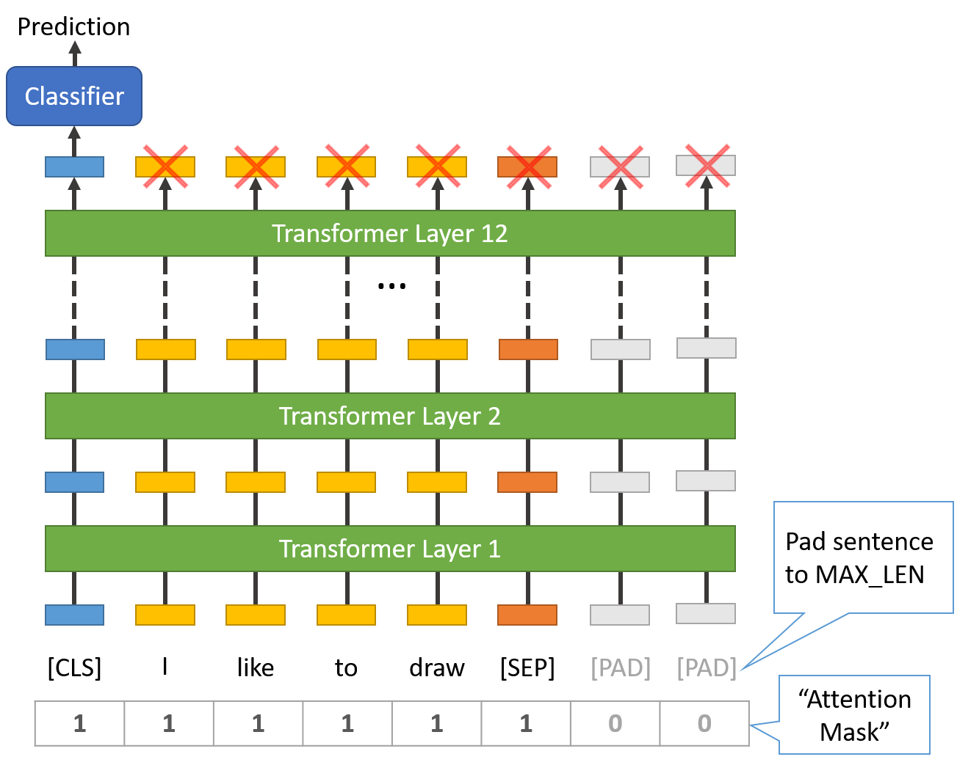
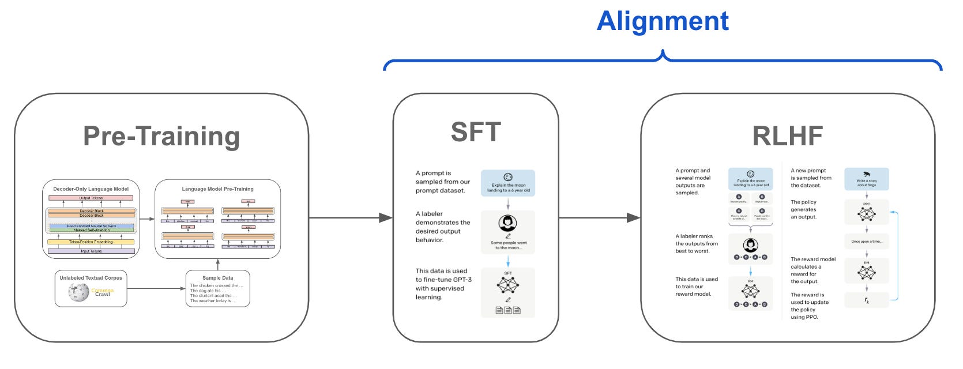
Language Model Finetuning
self-supervised pre-training on massive data sets (→ foundation models like GPT or BERT)
subsequent supervised finetuning on specific data sets (adapting parameters or/and adding layers )
example: sequence classification
purely predictive
tuning predictive, output generative
source
source
sentence classification via [CLS] token
source

Slide 13
Generative AI

Slide 14

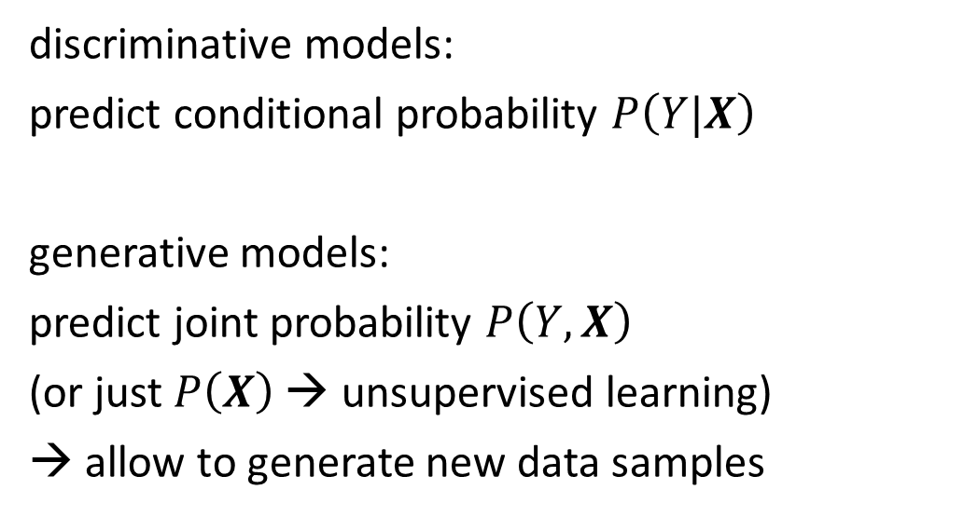
Generative vs Predictive/Discriminative Models
discriminative model
generative model
discriminative models:
predict conditional probability $P\left(Y|X\right)$
generative models:
predict joint probability $P\left(Y,X\right)$
(or just $P\left(X\right)$ → unsupervised learning)
→ allow to generate new data samples
source
task of generative models more difficult: need to model full data distribution rather than merely find patterns in inputs to distinguish outputs
Generative models can be used for predictive tasks (Bayes theorem).
But predictive models are usually better at it.

Slide 15
Deep Learning for Generative AI
Depending on the application, there are currently two dominant approaches for generative AI:
text generation: decoder LLMs
image synthesis: diffusion models
note the difference between image synthesis and multimodal understanding in LLMs (images as additional input sequences to transformer, tokenized by splitting into patches)

Slide 16

Encoder vs Decoder LLMs
most new LLMs decoder-only
encoder-only LLMs
prime example: BERT
self-supervised pre-training: masked-word prediction
finetuning on downstream tasks (e.g., sequence classification)
can’t generate text
can’t be prompted
decoder-only LLMs
prime example: GPT
self-supervised pre-training: next-word prediction
instruction tuning (e.g., RL from human feedback)
generate text: chat bots
prompt engineering (zero-/few-shot)
aka causal
source

Slide 17
Text Generation
in-context learning as alternative to finetuning (new paradigm):
feed information into LLM via input prompt (decoder LLMs)
→ attention to context
typical prompt:
instructions, context (potentially retrieved), query, output indicator
enables multi-task capabilities (all of ML before was only narrow tasks)
→ assistants

Slide 18
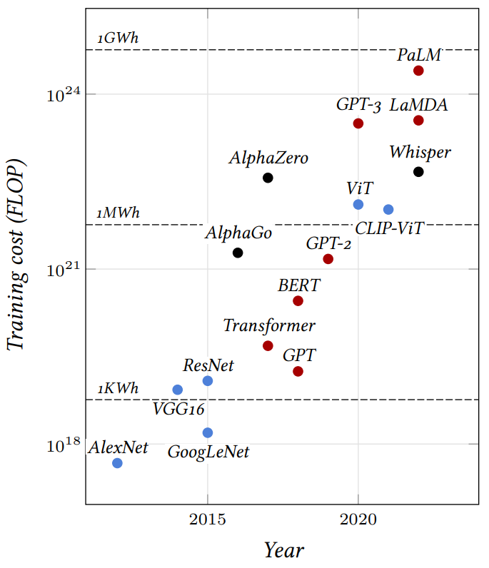
some deep learning history:
(open-source) LLM SOTA (July 2024): Llama 3
some LLM numbers (example Llama 3 405B):
vocabulary size (tokens): 128K
embedding/model dimensions: 16,384
parameters: 405B
training tokens: 15.6T
context length/window (tokens): 128K
training hardware: 16K GPUs (H100)
factor less than 40
→ a lot of memorizing
another trend: small language models on edge devices
source

Slide 19


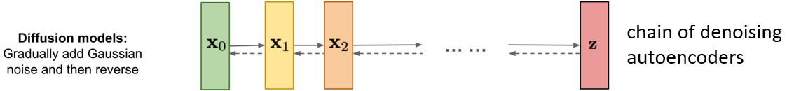
Image Synthesis
example: DALL-E 2
idea: generate new images as variations of training data
usually conditioned on text (prompt) by transformers
compared to text generation, additional mechanism needed (e.g., diffusion) to create more complex structures
Variational AutoEncoder:
from wikipedia
source

Slide 20


plenty of applications: DALL-E, Stable Diffusion, ImageGen, Midjourney, ...
also text-to-speech (VALL-E, Speech T5, …) (and speech recognition, e.g., Whisper), text-to-video (Make-A-Video, Lumiere, Sora, …) → dynamics/physics understanding/simulation
rather “translations”
inpainting example (GLIDE ):
web app for Stable Diffusion: DreamStudio
source
prompt
at some point maybe also proteins, materials, structured data, …

Slide 21
Decision Making

Slide 22
Sequential Decision Making
predictive
no concrete input-output examples like in supervised learning
typically, domain of
reinforcement learning (e.g., Q-learning or policy-gradient methods → model-free)
optimal control (e.g., model predictive control → model-based)
plenty of use cases: e.g., games or complex control mechanisms

Slide 23
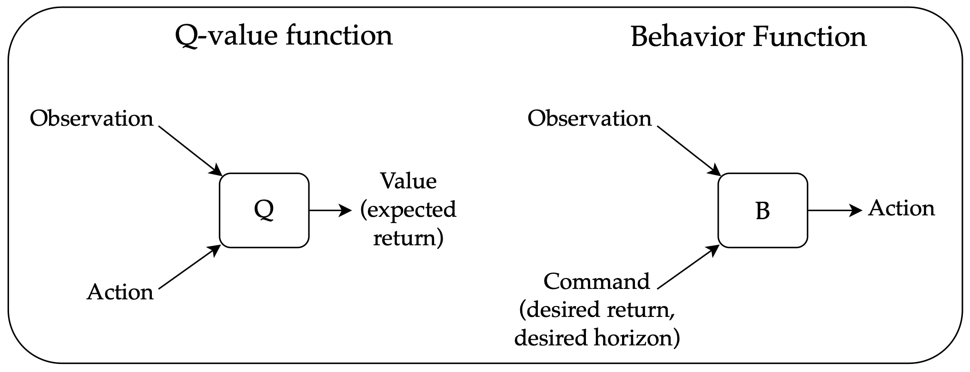
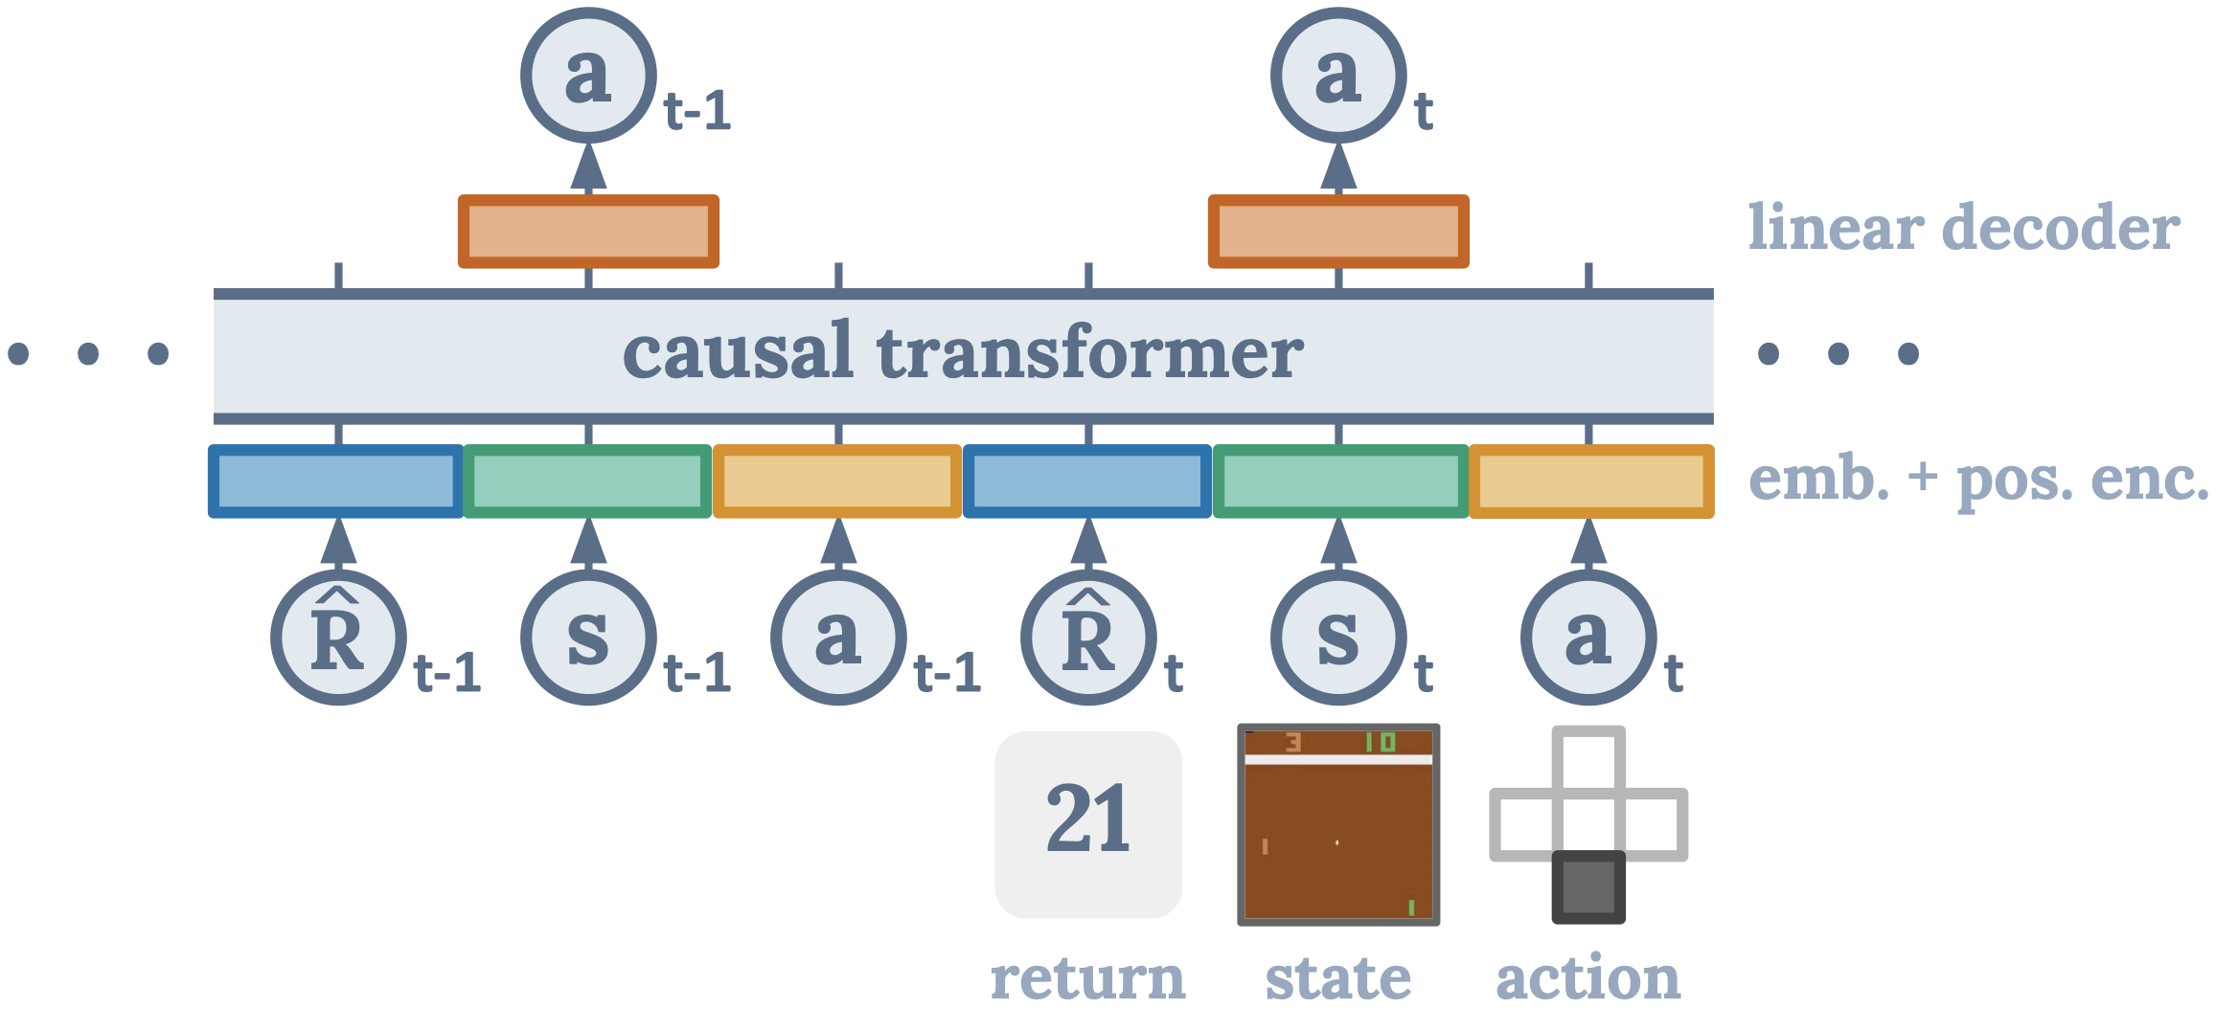
Alternative: Sequence Modeling
generative
offline method
not restricted by Markov property
Decision Transformer:
generative: transformer to autoregressively model trajectories
credit assignment directly via self-attention: state-return associations
desired return tokens as prompt for action generation (but extrapolation is difficult)
overcoming the deadly triad of deep RL:
source
source
or apply language models directly ...

Slide 24
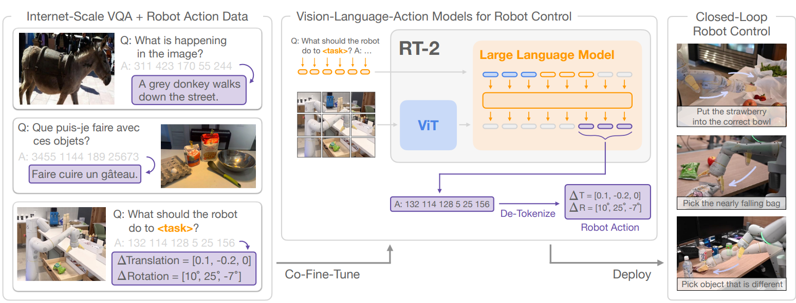
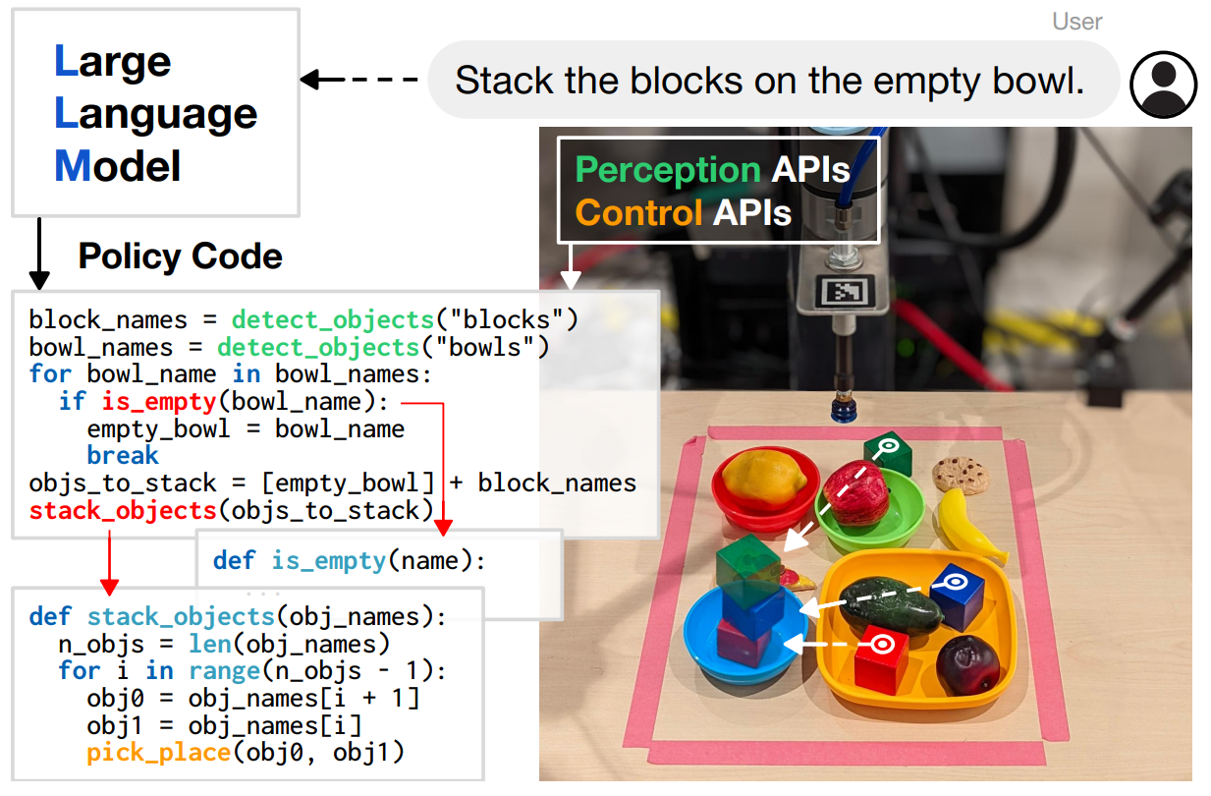
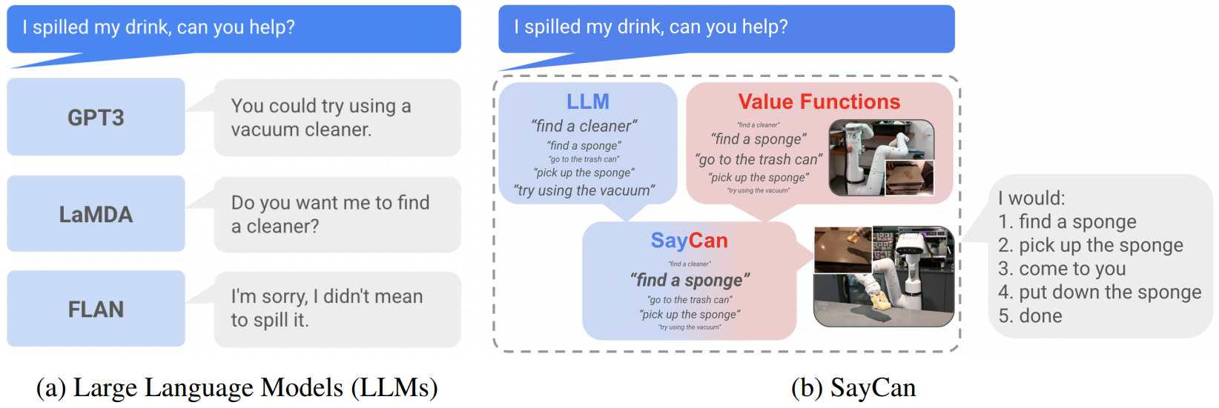
Example Use Case: Robotic Control generated by LLMs/VLMs
RT-2:
diffusion objective for multimodal outputs
Code as Policies:
SayCan (grounding with pre-trained skills):

Slide 25
Agents

Slide 26
LLM Agents
desired agent capabilities:
planning (LLMs: decomposition of complex issue in multiple simple steps)
tool use (LLMs: use predictive models for numerical/optimization tasks)
reflection (LLMs: clever prompting schemes)
collaboration with other agents (LLMs: mutual prompting)
(but capabilities still limited, e.g., reasoning)

Slide 27
Goal: Autonomous End-to-End Workflow
LLM/VLM agent
RAG
tool usage
control
domain knowledge
prediction, optimization
decision making
input
input
perception

Slide 28
So, when to use what, now?
Deep learning (especially as foundation models) rules for unstructured, classic ML (specific models) is (still) a good choice for tabular data.
Generative models allow to create new data (text, code, images, video) and can be used in a very generic way (prompting).
But predictive models are usually better for predictive tasks, and business problems are often predictive (numerical, optimization, …).
They can be combined: generative model (e.g., an LLM) as orchestrator, using predictive models as tools.

Slide 29
And some Philosophical Thoughts
Current AI (SOTA: LLM) is good at learning statistical patterns and making predictions.
But there is no sign of real “understanding”. → stochastic parrot?
Anyway, generative AI is an interesting, slightly twisted mirror of our creations.

